Slide 1
Date: 09 December 2025

Slide 2



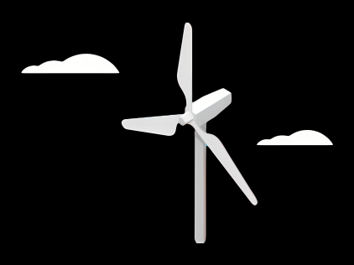
Weekly report: Team Gearbox, Brake, Coupling
Week number : 11
Date: 09/12/2025
Supervisor: Prof. Peter Quell
Group Members :Nehang Jitendra Joshi,Santo Mazumder,Md Razaul Karim Rahat
Presented by -Santo Mazumder
9-12-2025
Gearbox, Brake, Coupling

Slide 3
List of Content
Gears geometry calculation
Sketch of gearbox layout
3D design of all stage and housing
Force analysis and Stress calculation
Gearbox internal shaft calculation
Cost,Weight and supplier
9-12-2025
Gearbox, Brake, Coupling

Slide 4
Gears geometry calculation
Parameter | Value
Input torque,Mi KN m | 5,095
Output torque,Mo KN m | 41,9
Input speed, rpm | 10.12
Output speed, rpm | 1200
9-12-2025
Gearbox, Brake, Coupling

Slide 5
Gears geometry calculation
Parameter | 1st stage | 2nd stage | 3rd stage
Gear ratio | 5 | 4.9 | 4.9
No of Planets | 5 | 4 | NA
Module,(mm) | 16 | 14 | 9
Pressure angle | 20 | 20 | NA
Helix angle | 20 | 20 | NA
Input speed,rpm | 10.12 | 133.79 | 401.48
Output speed,rpm | 133.79 | 401.48 | 1200
9-12-2025
Gearbox, Brake, Coupling

Slide 6
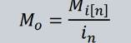
Gears geometry calculation
Parameter | Formula | 1st stage | 2nd stage | 3rd stage
Input torque |  | 5,095 | 23.8 | NA
Output torque |  | 23.8 | 41.9 | NA
Pitch diameter,d (mm) | m*zp m*zs m*zr | ds-592, dp-624 , dr-1840 | ds-490 , dp-525 , dr-1540 | 900 and 198
Outer dia ,Do (mm) | D0=(z+2).m | Ds-642,dp-676,dr-1900 | Ds-540,dp-560,dr-1600
Addendum,a(mm) | a=m | 16 | 14 | 9
Dedendum,b(mm) | b=1.25*m | 20 | 17.5 | 11.25
Face width,(mm) | 10 * module | 160 | 140 | 90
9-12-2025
Gearbox, Brake, Coupling

Slide 7
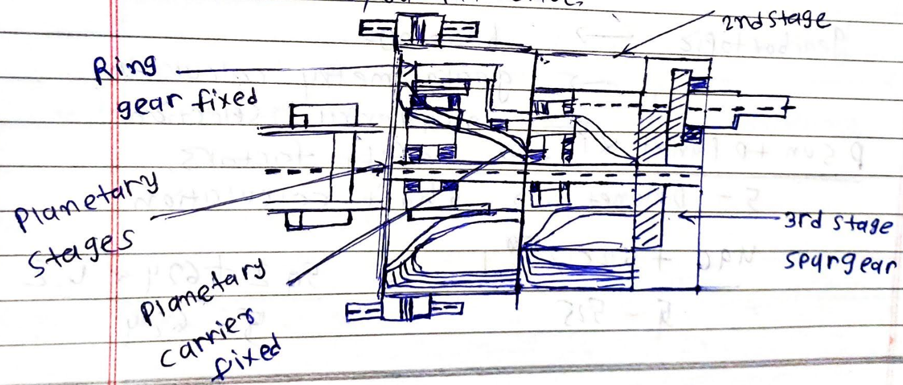
Sketch of the Gear box Layout
Reference: Own sketch
9-12-2025
Gearbox, Brake, Coupling

Slide 8
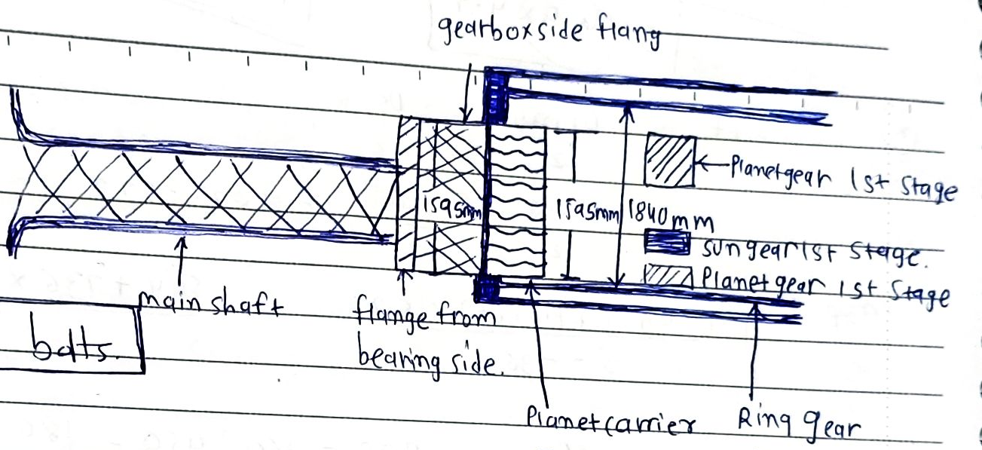
Sketch of the Gear box Layout
Reference: Own sketch
9-12-2025
Gearbox, Brake, Coupling

Slide 9
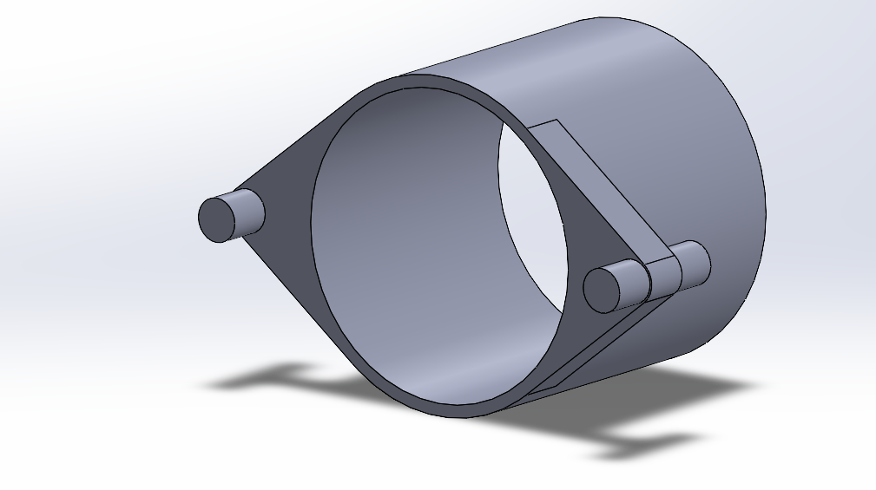
3D model gearbox housing
Reference: Own design
9-12-2025
Gearbox, Brake, Coupling

Slide 10
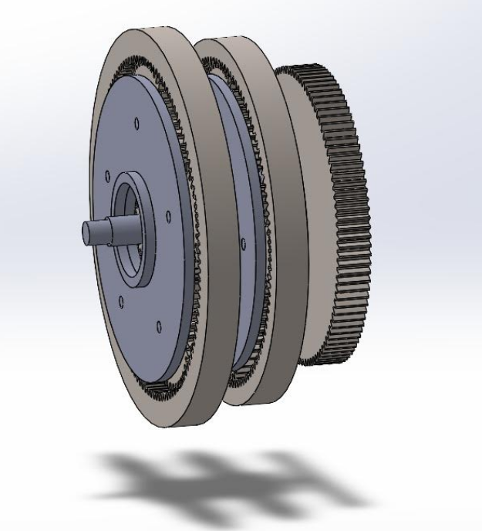
3D model design of all stages
Reference: Own design
9-12-2025
Gearbox, Brake, Coupling

Slide 11
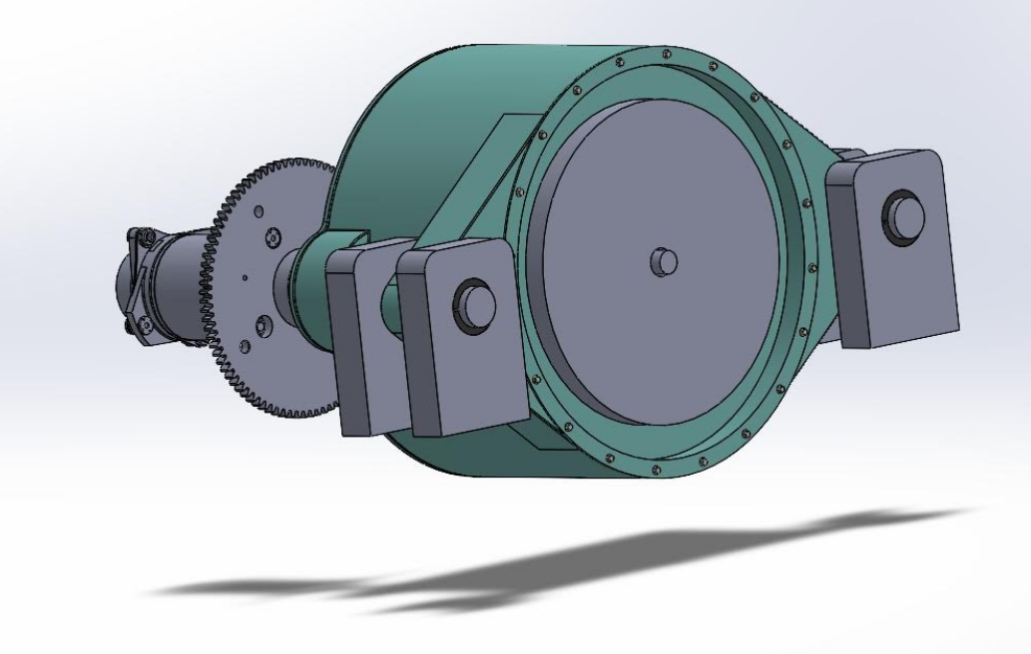
3D model design of all stages
Reference: Own design
9-12-2025
Gearbox, Brake, Coupling

Slide 12
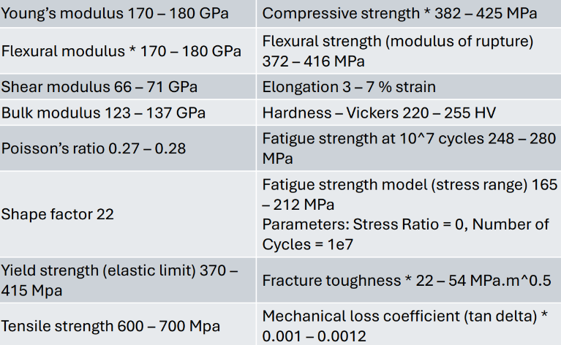
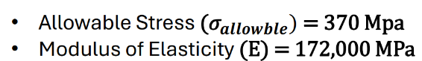
Cast iron,Mechanical Properties
9-12-2025
Gearbox, Brake, Coupling

Slide 13
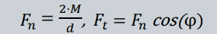

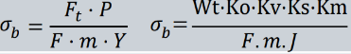
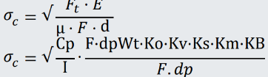
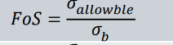
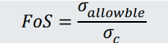
Force analysis, Stress, and Safety Factors (Zr-Ring gear)
Parameter | Formula | 1st stage | 2nd stage
Input torque,M (MNm) | Mi-5,095 M2=M1/i1 | 5,095 | 1.01
Tangencial force,Ft (MN) |  | 3.481 | 0.788
Radial force Fr (MN) |  | 1.567 | 0.587
Bending stress (m (MPa) |  | 137.89 | 92.67
Contact stress C,(MPa) |  | 216.57 | 170.34
Factor of safety (Bending) |  | 2.45 | 3.2
Factor of safety (Contact) |  | 1.38 | 2.11
9-12-2025
Gearbox, Brake, Coupling

Slide 14
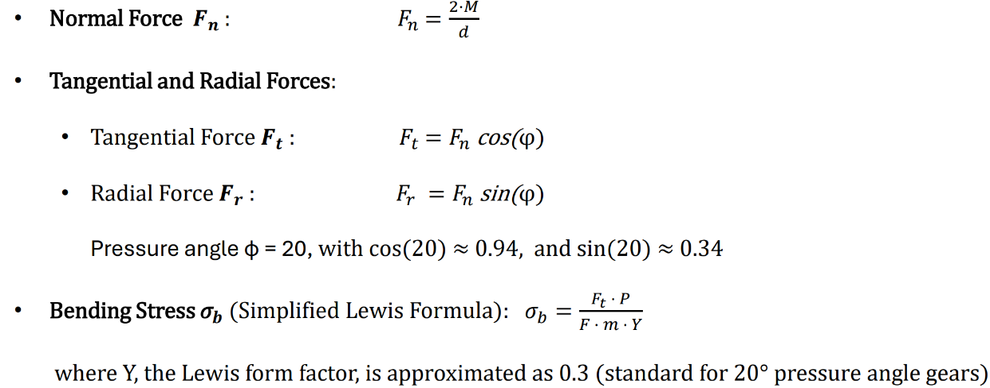
Force analysis, Stress calculation
Reference: AGMA 2101-DO4 Standard and Optimus shakti
9-12-2025
Gearbox, Brake, Coupling

Slide 15
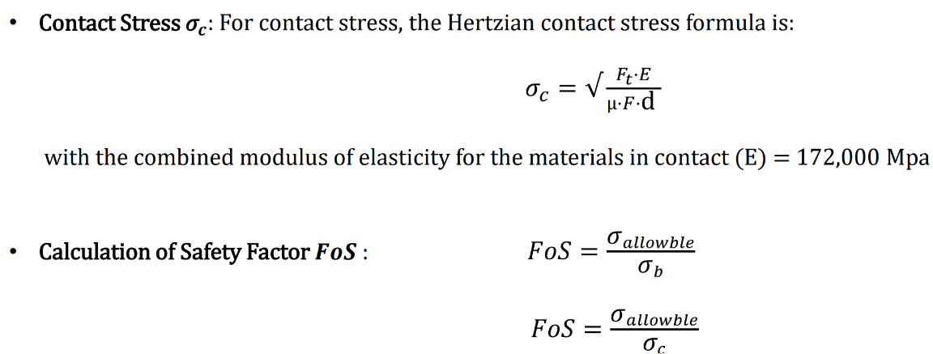
Force analysis and Stress
Reference: AGMA 2101-DO4 Standard and Optimus shakti
9-12-2025
Gearbox, Brake, Coupling

Slide 16
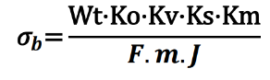
Force analysis and Stress
σb: Bending stress in the gear teeth
Wt: Transmitted tangential load (force) at the pitch line
Ko: Overload factor, accounting for unexpected loads
Kv: Dynamic factor, accounting for dynamic effects due to speed
Ks: Size factor, adjusting for differences in gear size
Km: Load distribution factor, accounting for uneven load across the gear face
J: Geometry factor for bending strength, which depends on the gear geometry
Reference: AGMA 2101-DO4 Standard and Optimus shakti
9-12-2025
Gearbox, Brake, Coupling

Slide 17
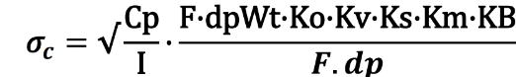
Force analysis and Stress
σc: Contact stress in the gear teeth
Wt: Transmitted tangential load (force) on the gear teeth
Ko: Overload factor (accounting for any unexpected loads)
Kv: Dynamic factor (accounts for dynamic effects due to speed)
Ks: Size factor (adjusts for size differences in gears)
Km: Load distribution factor (adjusts for uneven load across the gear face)
KBK_BKB: Rim thickness factor (related to the gear blank design)
Cp: Elastic coefficient, which depends on the materials used for the pinion and gear
I: Geometry factor for pitting resistance, which depends on the gear geometry
Reference: AGMA 2101-DO4 Standard and Optimus shakti
9-12-2025
Gearbox, Brake, Coupling

Slide 18
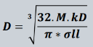
Gearbox internal shafts calculations
Stage | Gear type and Face width,mm | Shaft diameter | Length (mm) | Width (mm) | Hight (mm) and depth(mm)
 |  |  | L=min(1.5*d,b) | W=D/4 | T=D/6 K.d=T/2
1st stage | Sun gear-160mm | 160 | 160 | 40 | 26.66 13.33
1st stage | Planet gear-160mm | 110 | 160 | 27.5 | 18.33 9.16
2nd stage | Sun gear-140mm | 138 | 140 | 34.5 | 23 11.5
2nd stage | Planet gear-140mm | 80 | 140 | 20 | 13.33 6.66
9-12-2025
Gearbox, Brake, Coupling

Slide 19
Weight and Cost estimation
No | Components | Weight estimation | Cost estimation
1 | Gearbox Housing * 1 | 8000-9000 Kg | 16200 €
2 | Gears | 7000-7500 Kg | 34000 €
3 | Bearings | 1100 Kg | 2100 €
4 | Brake * 1 | 150 Kg | 5000 €
5 | Coupling *1 | 200 Kg | 1200 €
6 | Internal shaft | 3000 Kg | 13000 €
Total Weight | 24,400 Kg
Total cost | 90,000 – 1,35,000 €
Source-https://www.indexbox.io/search/cast-iron-price-per-kg
9-12-2025
Gearbox, Brake, Coupling

Slide 20
Weight and Cost estimation Bolted flange connection
Weight and Cost | 4500 Kg and 32,500 €
Material | EN-GJS-400-18-LT
Bolts | M48
Source-https://www.indexbox.io/search/cast-iron-price-per-kg
9-12-2025
Gearbox, Brake, Coupling

Slide 21
Next Steps
Bearing calculation
Coupling design and calculation
Brake caliper design and calculation
9-12-2025
Gearbox, Brake, Coupling

Slide 22
Bibliography
Gearbox
Previous year Optimus projects(60E,92LE,Shakti 6-12-2025
Roloff Matek Maschinenelemente 7-12-2025
Lecture notes – Mechanical drive train by Prof.Peter Quell.6-12-2025
Shigley's mechanical engineering design and PSG data book 6-12-2025
DNV and IEC-61400-4 guidelines 6-12-2025
9-12-2025
Gearbox, Brake, Coupling

